Slide 1
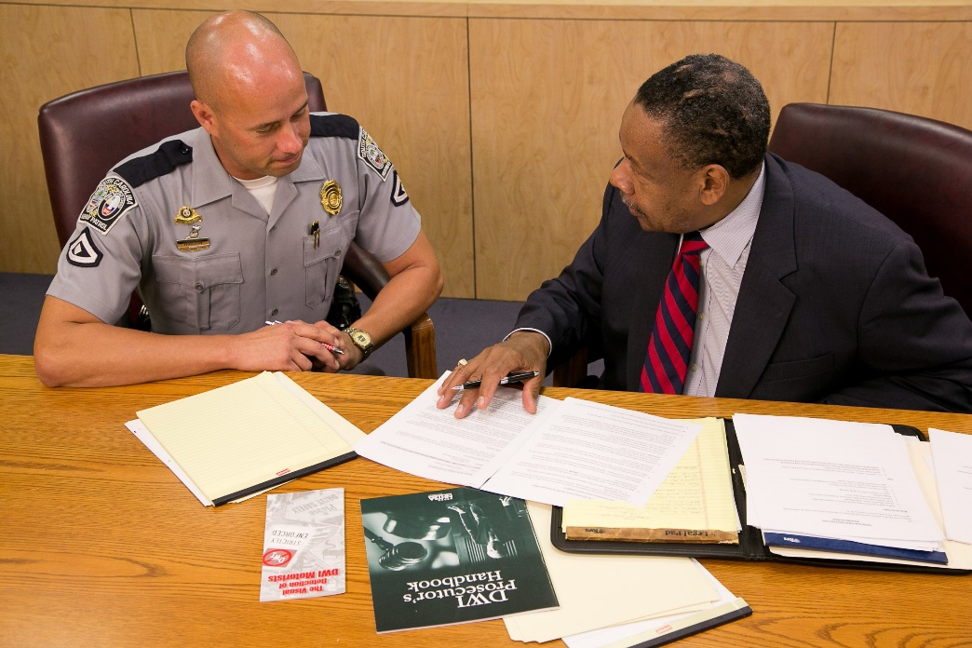



Session 8
Pre and Post
Arrest Procedures

Slide 2
Learning Objectives
Describe the Three Phases of DWI Detection Process
Describe effective roadside interview techniques
List elements of Driving While Under the Influence of Drugs (DUID) offense
Identify indicators of impairment during three phases of detection process

Slide 3
Learning Objectives
Accurately document, in sequence, observed impairment in each of the three phases of the detection process
Identify additional resources to support prosecution
Articulate relevant evidence as it relates to case preparation and prosecution

Slide 4
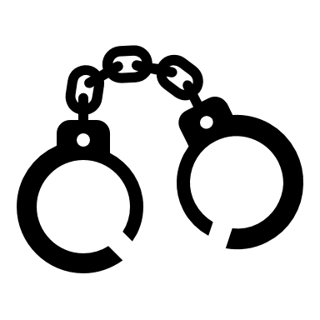
DWI Detection
Entire process of identifying and gathering evidence to determine if a subject should be arrested for a DWI violation.

Slide 5
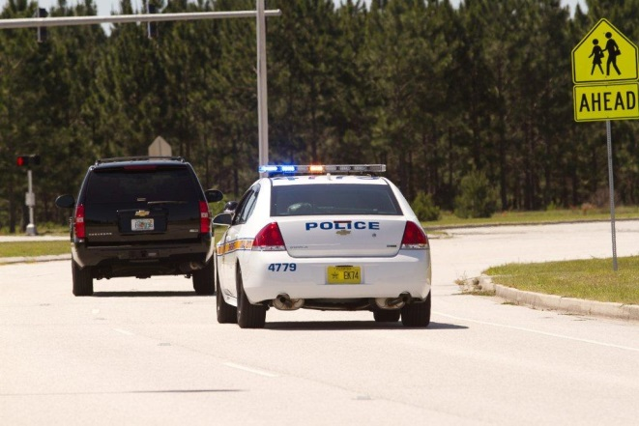
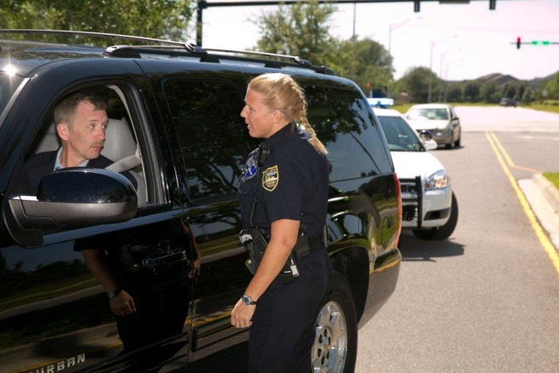
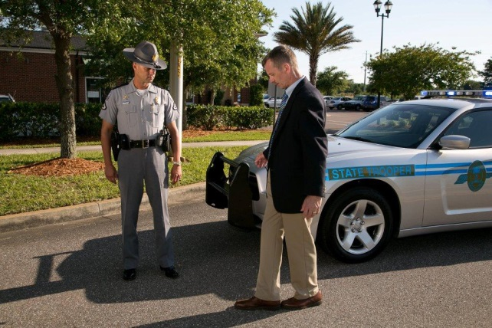
Three Phases
Pre-Arrest Screening
Vehicle in Motion
Personal Contact

Slide 6
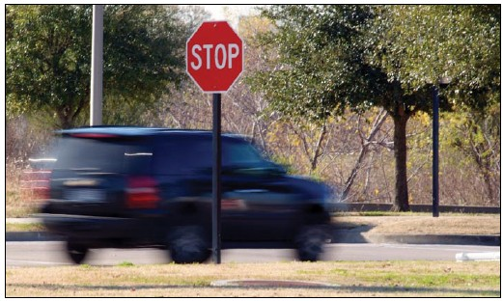
Phase One: Vehicle in Motion
What do you observe?
What do you do?
When might Phase One not occur?

Slide 7
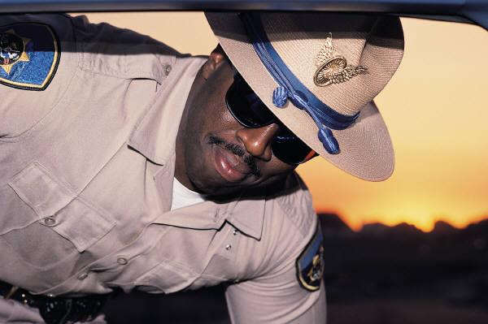
Phase Two: Personal Contact
What do you observe?
What do you do?
When might Phase Two not occur?

Slide 8
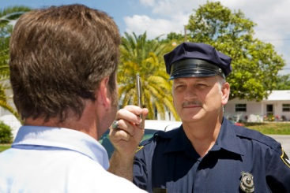
Phase Three: Pre-Arrest Screening
Administer SFSTs and additional ARIDE tests
Preliminary breath test

Slide 9
Each Detection Phase
Two major tasks
Each task has one major decision
Each decision has any one of three outcomes:
  Yes – Do it Now
  Wait – Look for Additional Evidence
  No – Don’t Do It

Slide 10
Phase One

Slide 11
Phase Two

Slide 12
Phase Three

Slide 13
Effective Roadside
Interview Techniques
This evidence is critical to successful prosecution of the DWI case
Necessary to gather valuable information during detection
Learn and practice effective roadside interview techniques

Slide 14
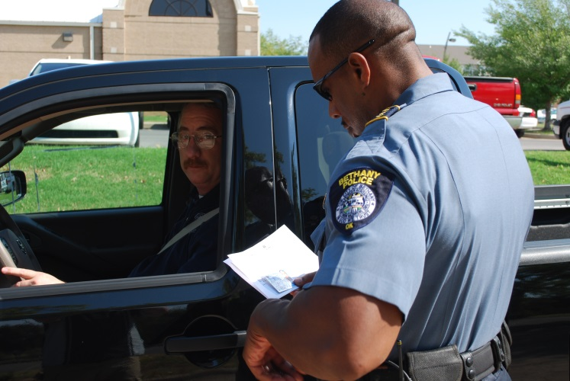
What You Say
Word choice
Communication style
Tailor questioning speed and tone to the situation and circumstances

Slide 15
What You Do
Physical positioning, demeanor
Goal: encourage cooperation
Facilitate open dialog
Develop a good rapport with the subject

Slide 16
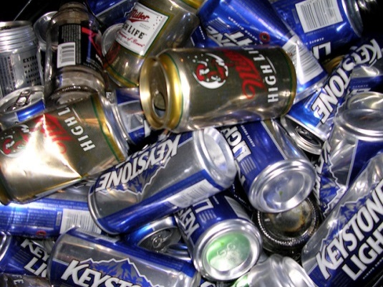
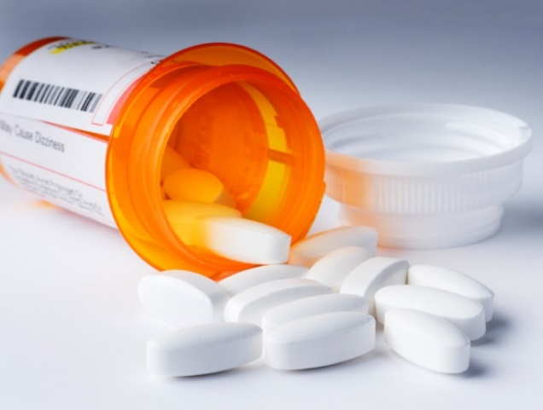
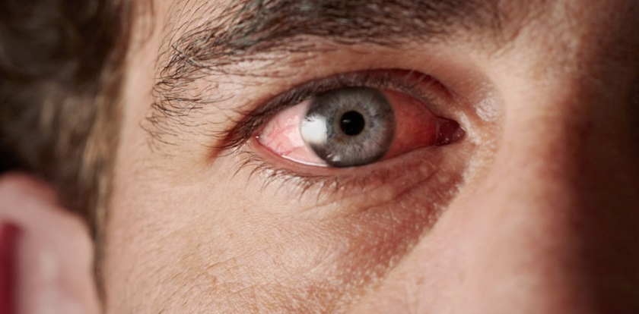
What You See, Smell, Hear

Slide 17


Identifying and Documenting
Detection begins with observation of the vehicle:
Document in order of the 3 Phases
Document environmental and other conditions

Slide 18

If you didn’t write it down,
It didn’t happen

Slide 19
Case Preparation
Know your Legal Requirements
Develop Case File
Don’t skip steps
Know your limitations
Ask for help

Slide 20
During the Detection Process
Keep in mind your State legal requirements
Organize and document observations in terms of the three detection phases
Successful prosecution for impaired driving begins with building a DWI prosecution team

Slide 21
Prosecution Team

Slide 22
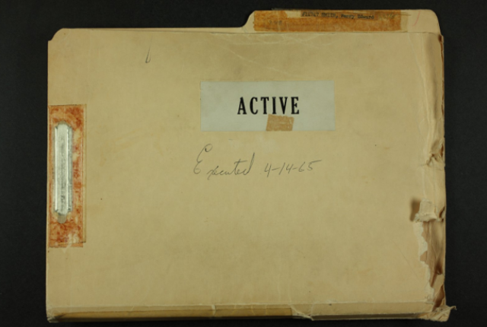

What is in a Case File?
Remember
Comprehensive Case Preparation Yields Effective Courtroom Presentation

Slide 23
Phase One:
Who Can Help?
Officer who observed driving and/or made traffic stop
Other officers
Lay witnesses

Slide 24
Phase Two:
Document Observations
Note every observation made regarding personal contact
Include observations before and after subject exits vehicle
Documenting can reinforce reasonable suspicion for the stop

Slide 25
Phase Three:
Thoroughly Document
HGN, WAT, OLS and other sobriety tests, including associated clues
Potential team members:
  Law enforcement officer(s)
  Lay witnesses

Slide 26
Post Arrest Process
Potential Team Members
Breath testing operators/technical supervisors
DREs
Medical personnel
Jail personnel

Slide 27
Pre-Trial Preparation
Who Can Help?
Local Prosecutor
Toxicologist
DRE/DRE State Coordinator
TSRP
IACP DEC Program Coordinator
NHTSA/NAPC Prosecutor Fellow
NTLC

Slide 28
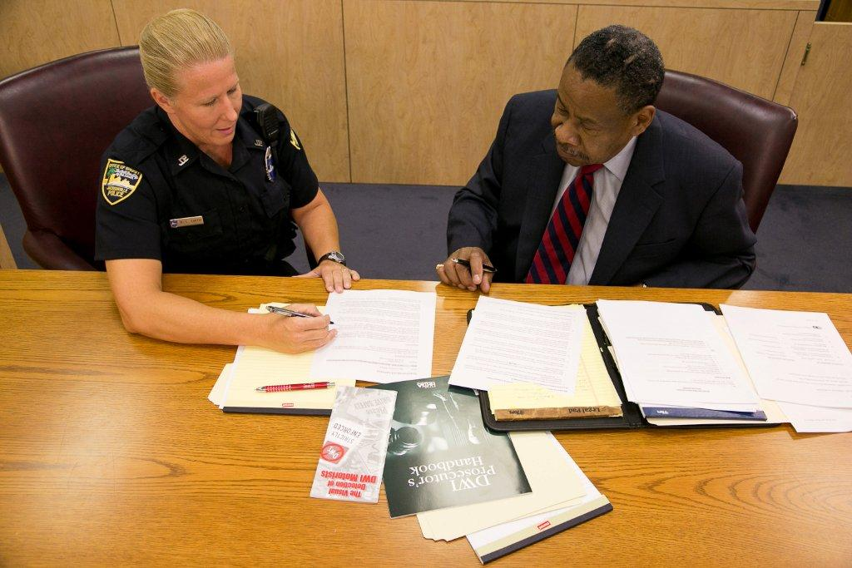
Pre-Trial
Review your case file
Meet with prosecutor
Anticipate defense
Develop visual aids
Other

Slide 29
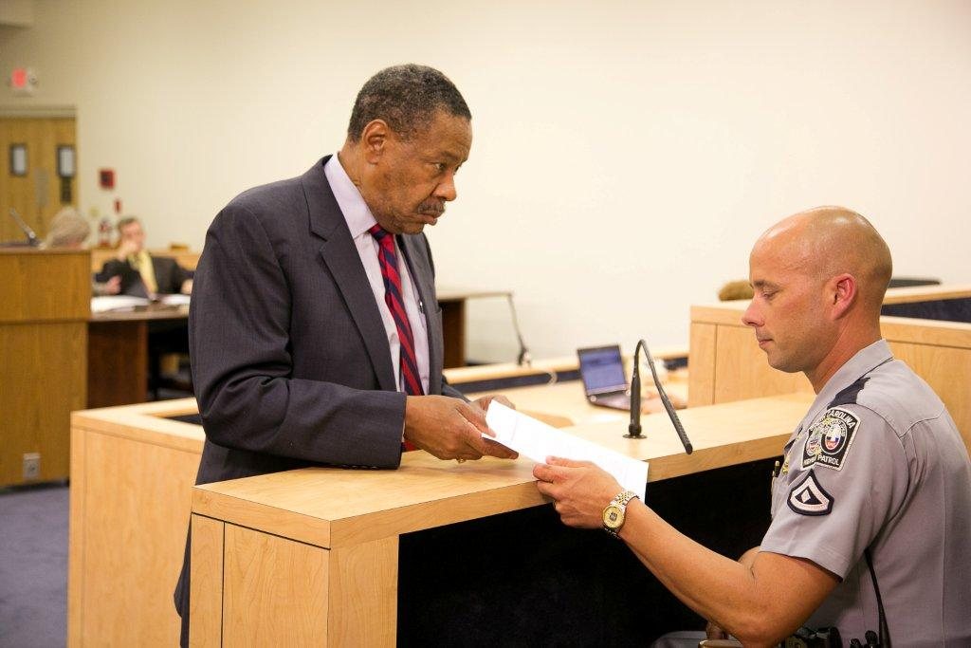
Trial

Slide 30

Are you prepared?

Slide 31
Questions?

